Slide 1
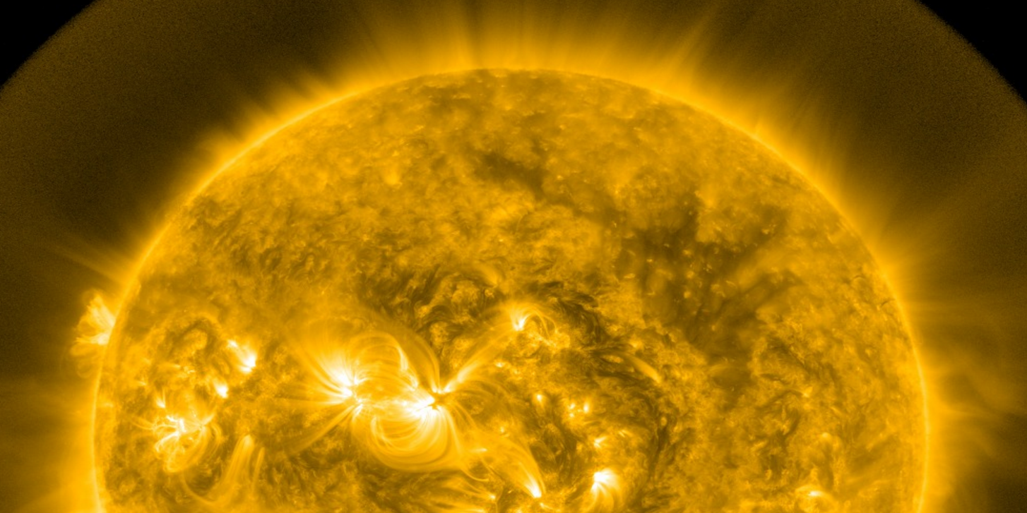
Solar Flares
Building a New Forecasting Procedure
Mike McKeon, Evan Frangipane, and Anna Voelker

Slide 2
What are solar flares?
Massive bursts of energy that are characterized
by brightening observed on the sun. Associated with SEPs and Radio Outages.
Notes:
From ESA- http://www.esa.int/Our_Activities/Space_Science/What_are_solar_flares
-Solar flares are massive bursts of energy that are characterized by brightening observed on the sun.
-They are also associated with dangerous solar energetic particles (SEPs), which can damage spacecraft electronics and pose a threat to astronaut safety.
-Flares travel at the speed of light and SEPs travel at relativistic speeds up to 80% the speed of light, so in order to be prepared for their potential effects, advanced notification is crucial to mission protection.
A solar flare is a tremendous explosion on the Sun that happens when energy stored in 'twisted' magnetic fields (usually above sunspots) is suddenly released.
In a matter of just a few minutes they heat material to many millions of degrees and produce a burst of radiation across the electromagnetic spectrum, including from radio waves to x-rays and gamma rays

Slide 3
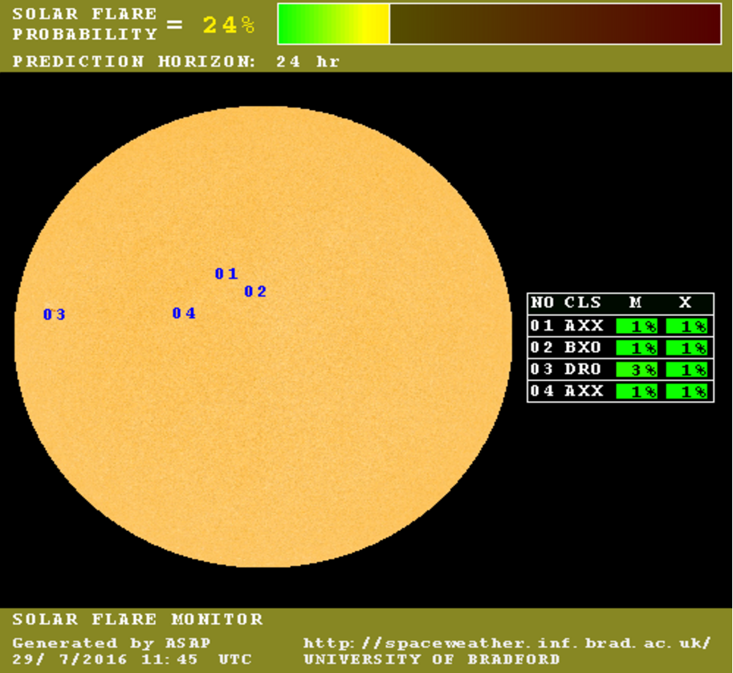
Automated Solar Activity Prediction (ASAP)
PROGRAM : ASAP RELEASE : 1.26-BETA RELEASE DATE : 19/10/2010 DATE : 01/06/2013 TIME : 00:00 GROUPS DETECTED: 3 01/06/2013 00:00 N12E39 HRX XXX 1 0 2 0.0904 0 0 0 01/06/2013 00:00 S07W11 HRX XXX 1 0 3 0.0904 0 0 0 01/06/2013 00:00 S14E13 DRO XXX 3 4 8 0.0739 0 0 0
ASAP was created at the University of Bradford, UK. It generates solar flare predictions by identifying and classifying areas of extreme magnetic field intensity on the Sun. This classification is entered into an algorithm based on a historical database of over 70,000 flares in order to produce a probabilistic prediction of flare likelihood.

Slide 4
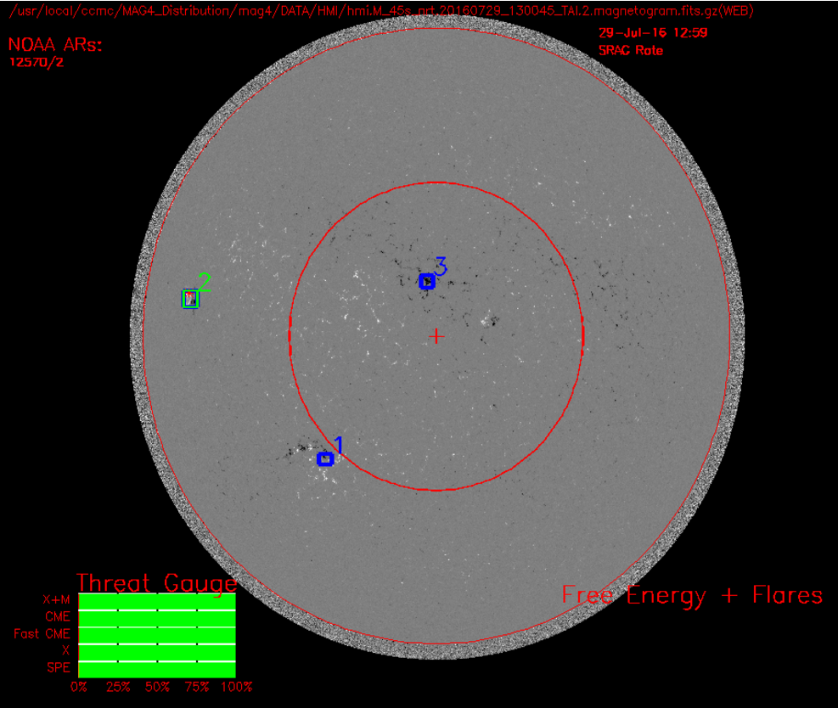
Magnetogram Forecaster (MAG4)
2015/04/02 07:59 WF=W+Flare # AR# WL!DSG!N Lng Lat 24 Hour Event Rate Dist (kG) (deg) M&X CME FCME X SPE (deg) 3 12317 5 36 10 0.005 0.001 0.001 0.005 0.002 37! Disk Forecast Rates 0.005 0.001 0.001 0.005 0.002
Multiplicative Uncertainties 0.4x 1.5x 0.9x 0.4x 2.0x Disk All-Clear Forecast Probabilities 99.50% 99.90% 99.91% 99.50% 99.80% Uncertainties 0.00% 0.05% 0.00% 0.00% 0.20%
MAG4 was created at the University of Alabama and predicts solar flares using magnetograms, which are solar images that depict magnetic field strength and polarity. Pattern recognition techniques are used to identify regions of high magnetic activity and determine probabilistic flare predictions.

Slide 5
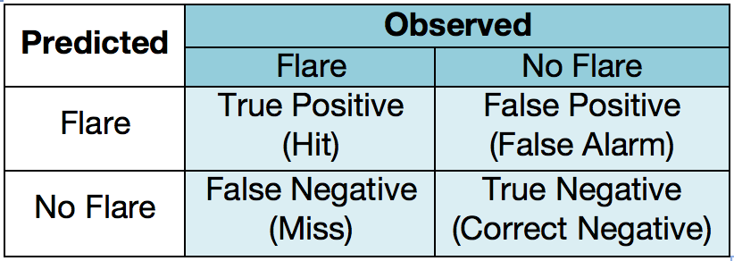
Contingency Table

Slide 6
Data Acquisition
-We scraped prediction percentages in 6hr increments from the iSWA data tree, 7308 forecasts for ASAP M and X, and 2924 for MAG4.
-There were many ‘None’ value measurements in the background, denoting large data gaps in each model.
-We used flares from the DONKI database, removing anything below M1.0 and greater than 60° longitude. There were 229 flares used for ASAP M, 136 for Mag4, and a mere 21 flares used for ASAP X for our chosen time periods.

Slide 7
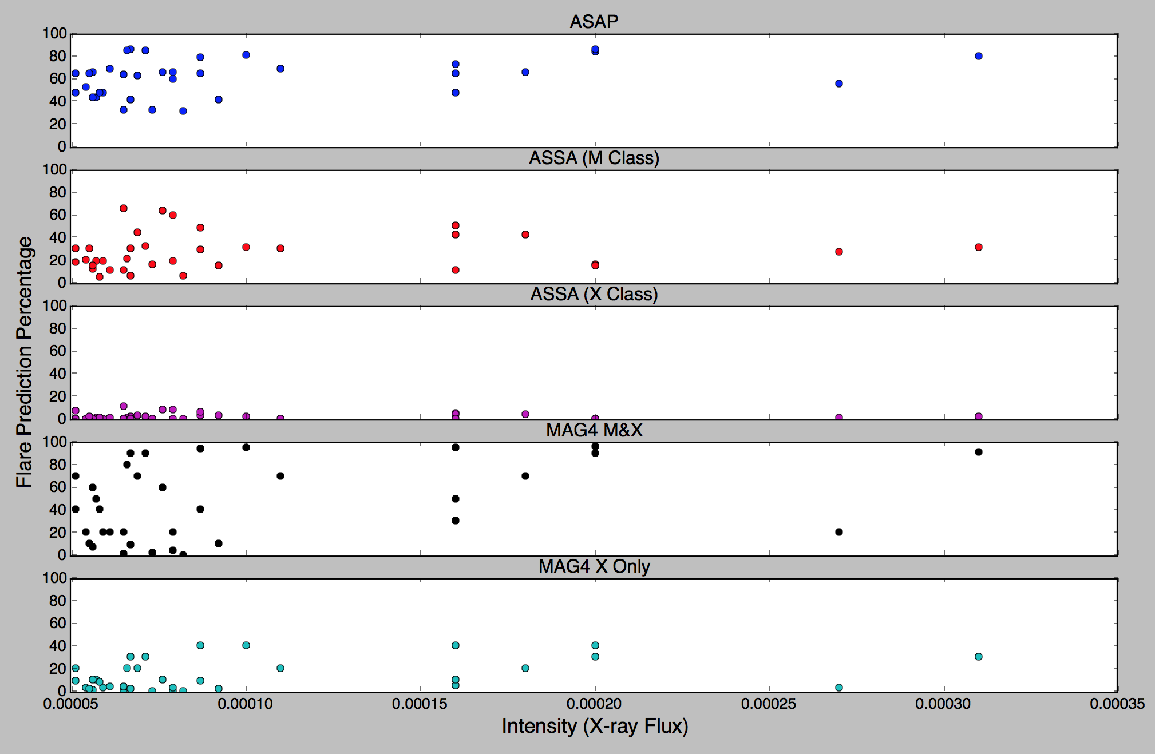
Notification Worthy Flares Across Models

Slide 8
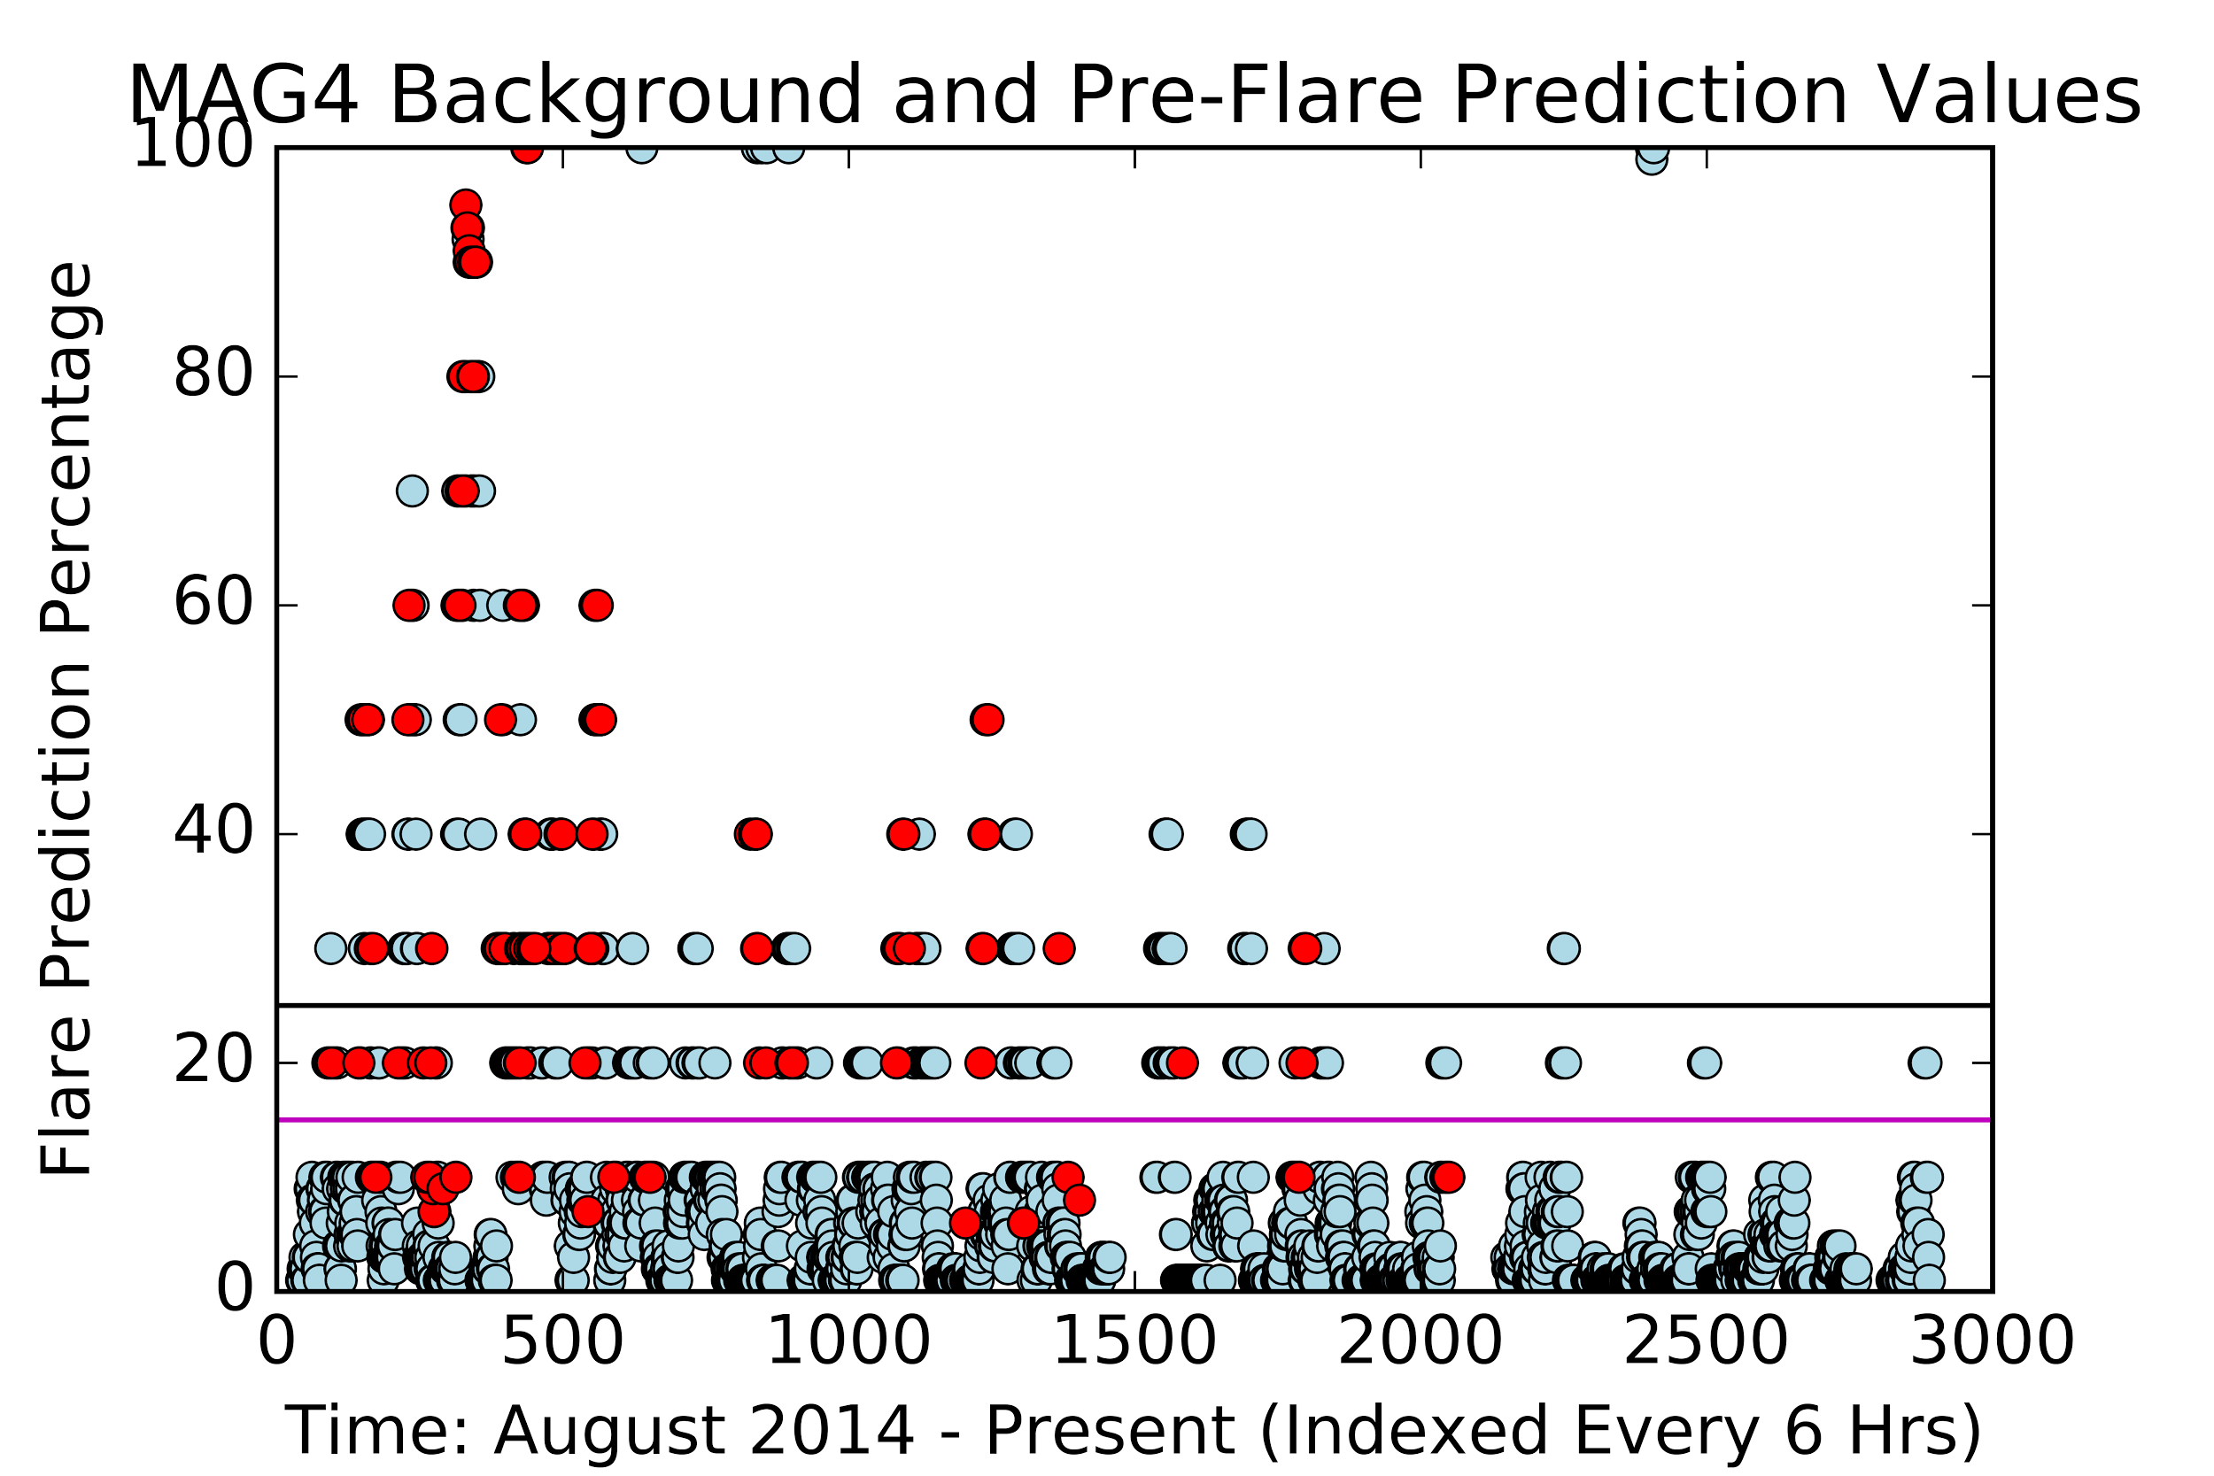
Background predictions with maximum pre-flare predictions overlaid
Notes:
Depiction of background predictions (7308 for both ASAP M and X and 2924 for MAG4 M&X) taken every 6 hours, with pre-flare prediction values (229 for ASAP M, 136 for MAG4, and 21 for ASAP X) overlaid.

Slide 9
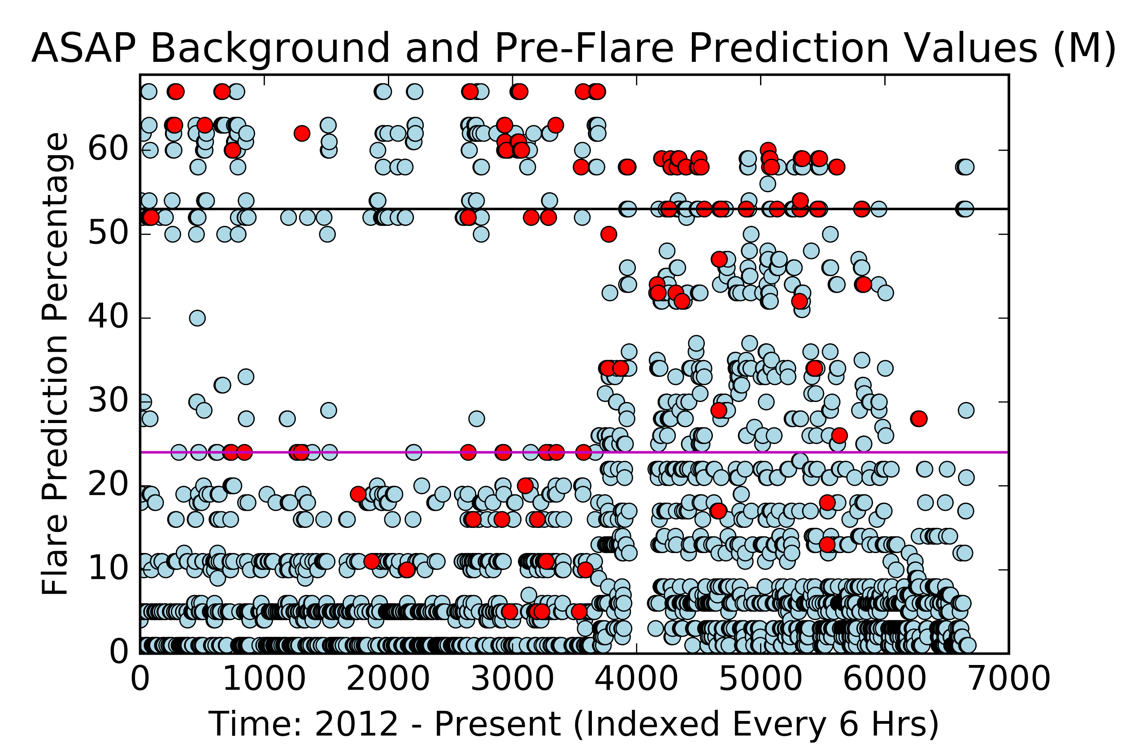
ASAP M

Slide 10
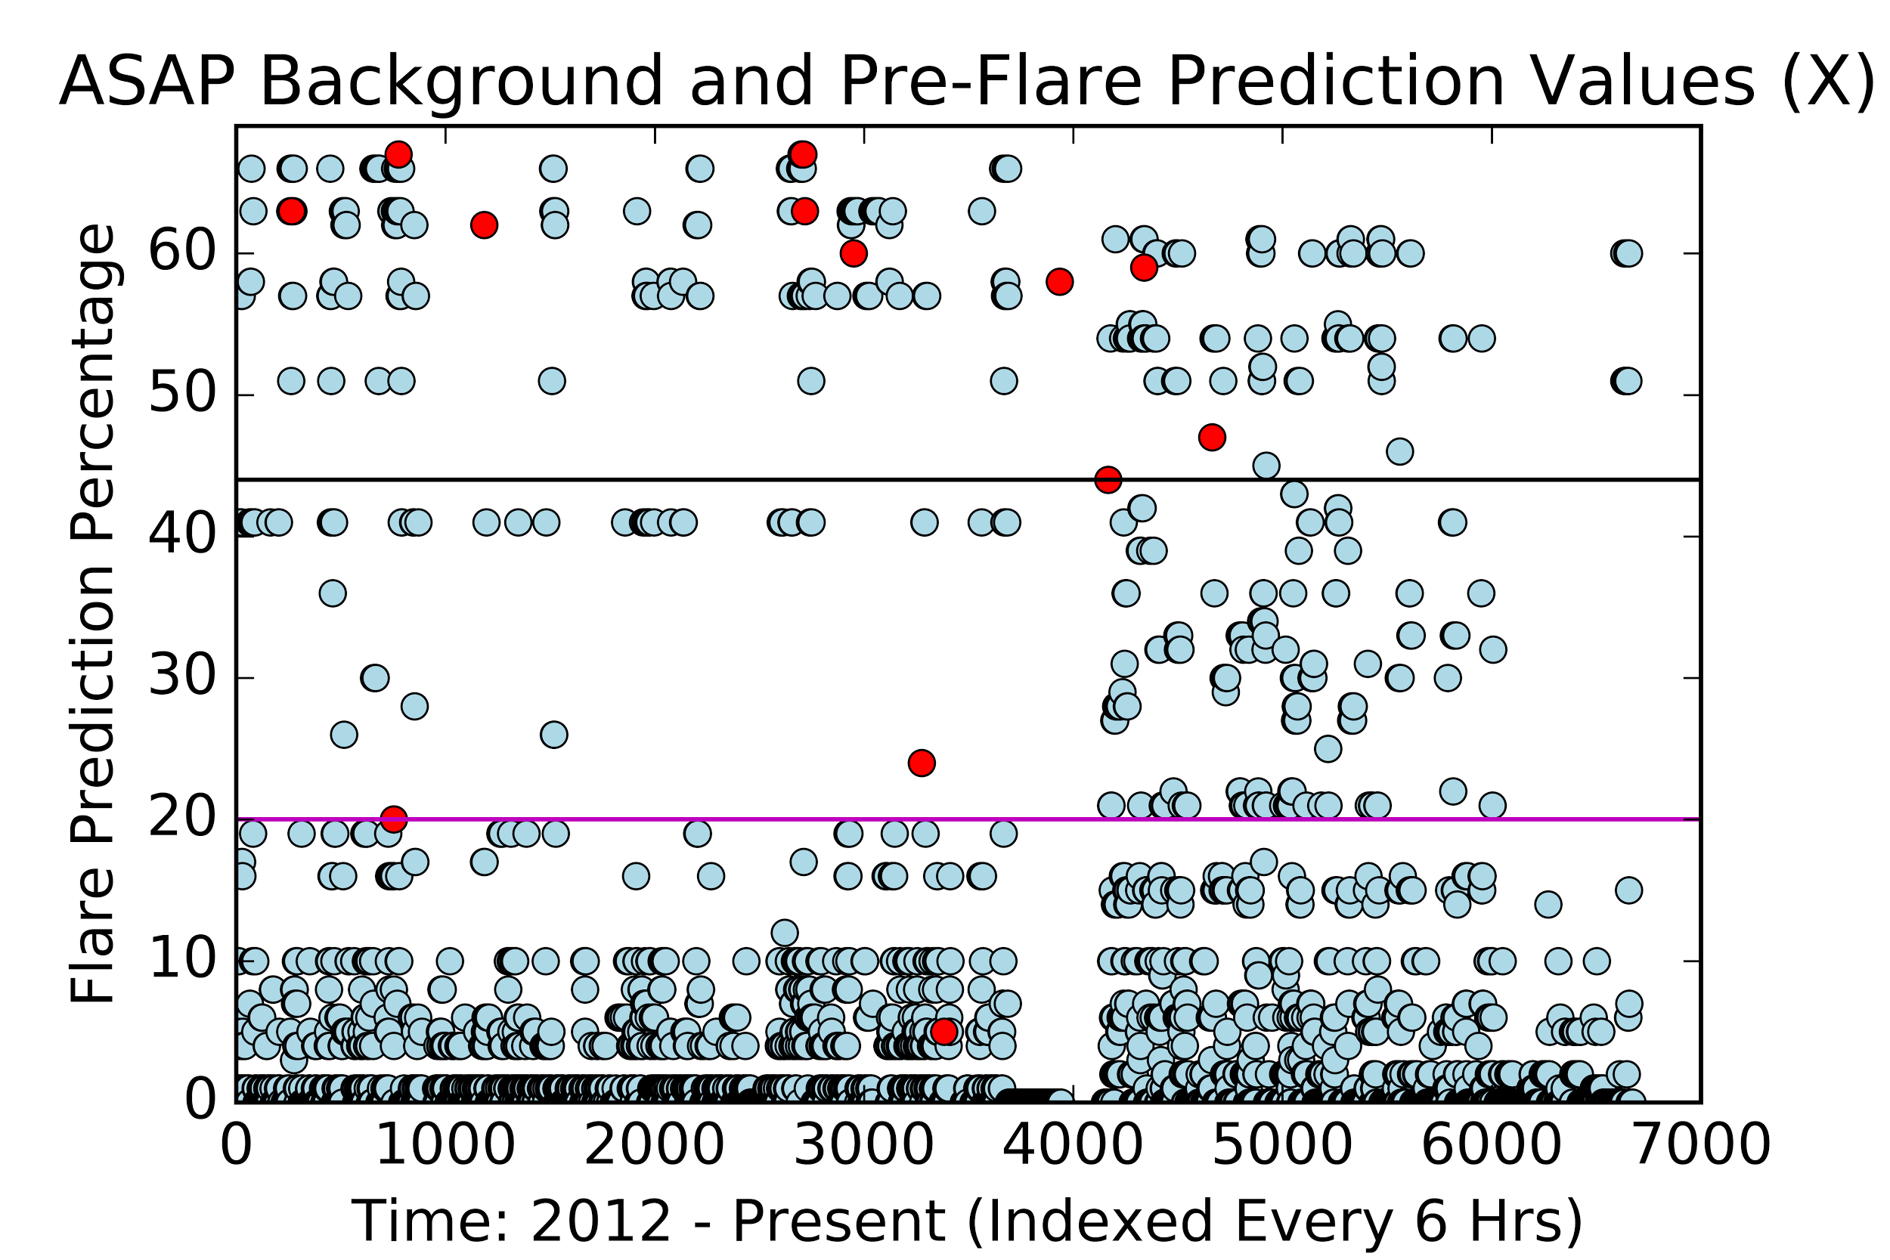
ASAP X

Slide 11
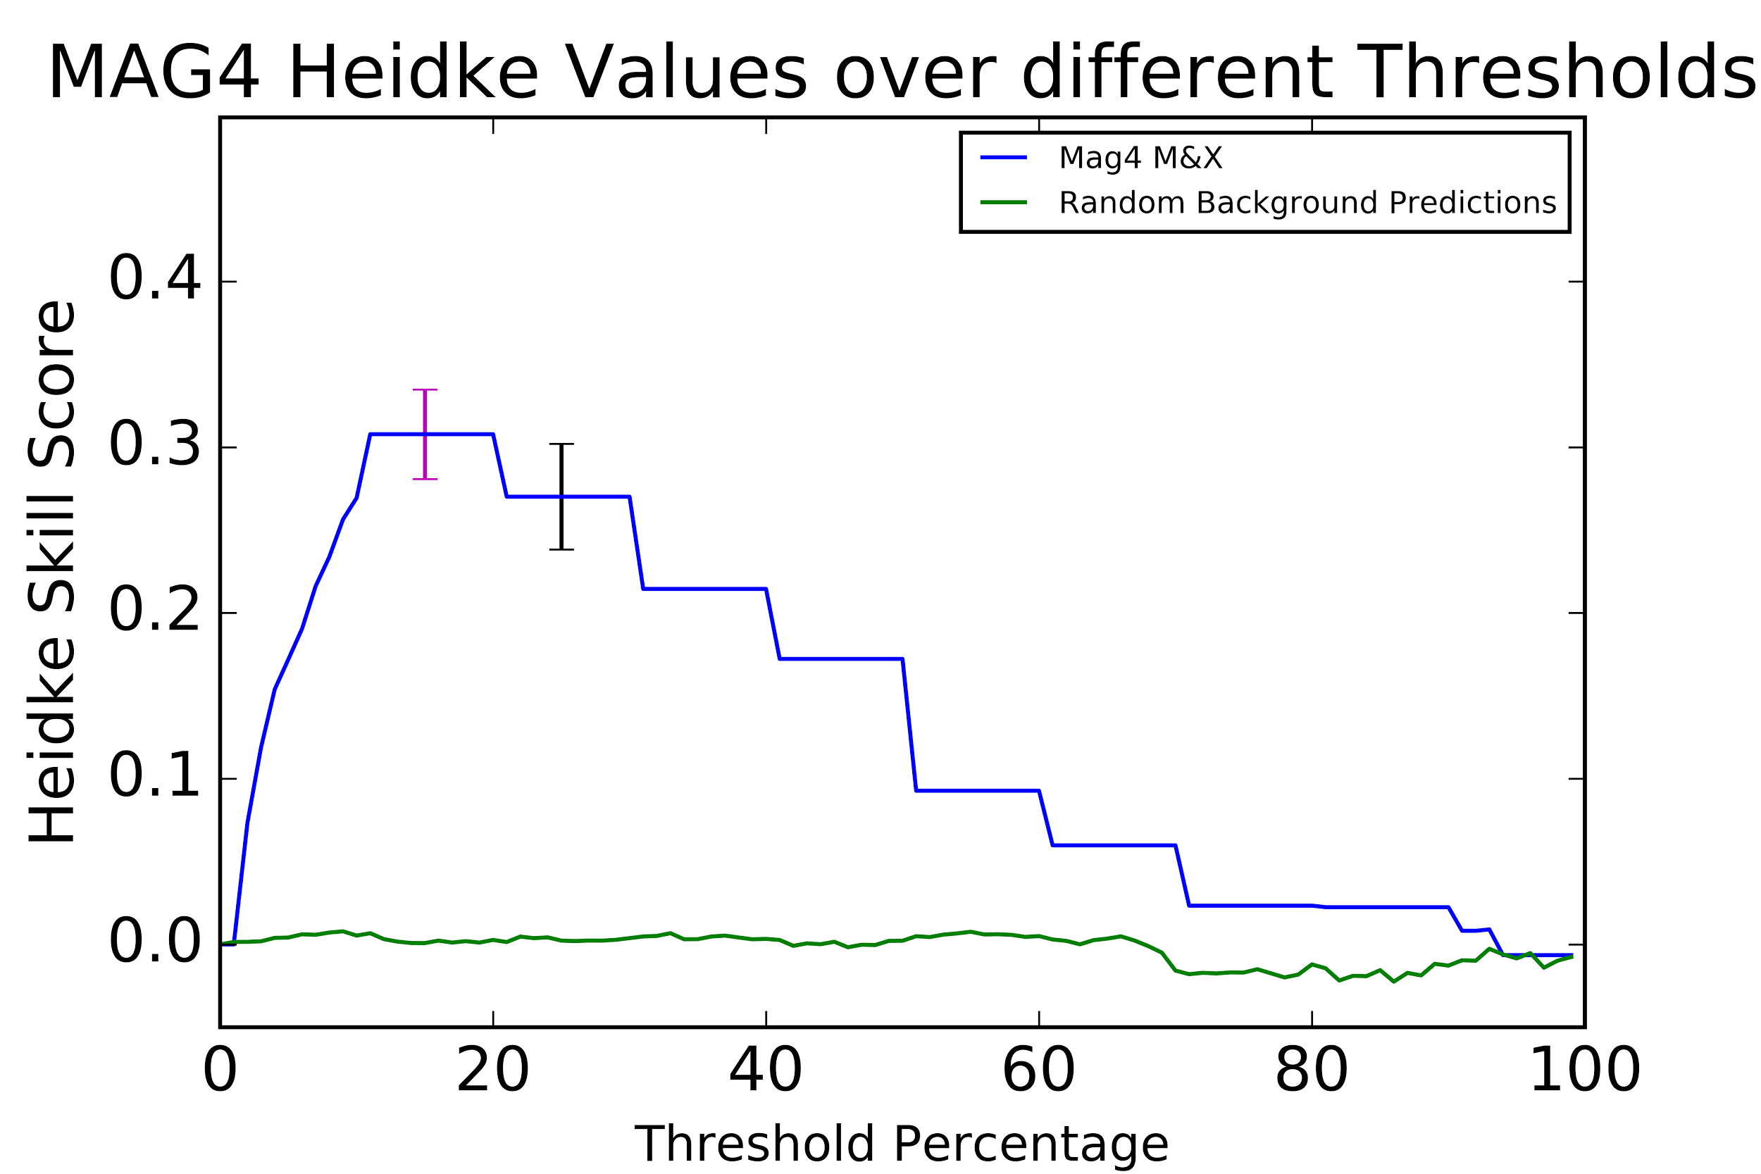
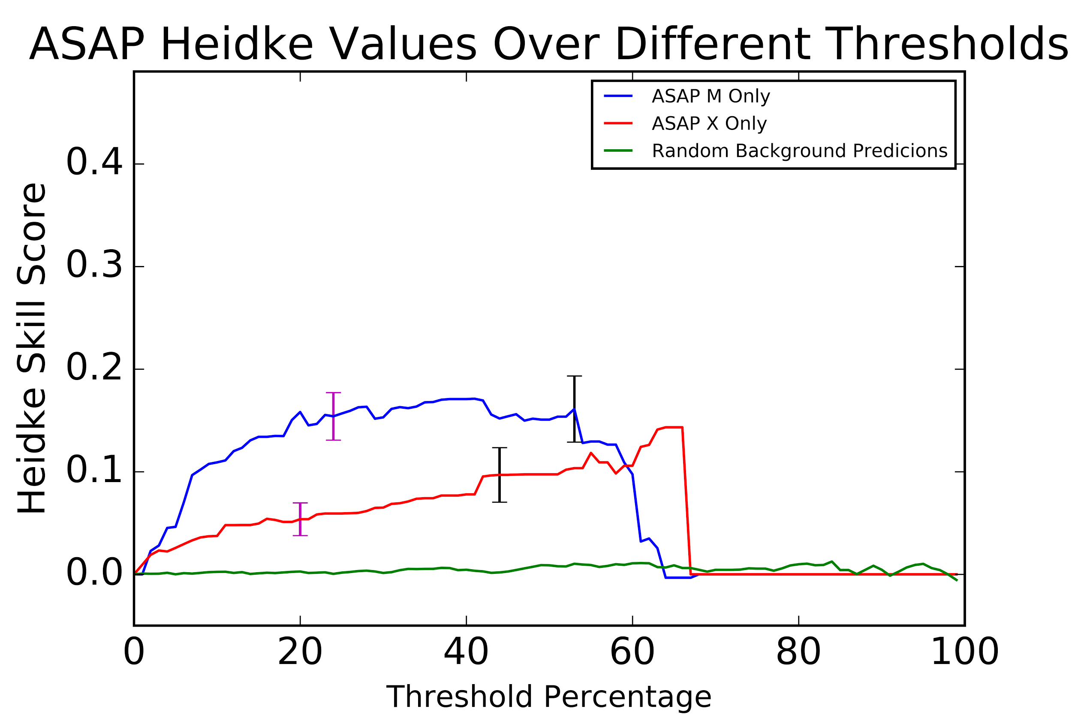
Heidke Skill Score
The Heidke Skill Score measures the degree of improvement of a model prediction relative to random. The range of scores is negative infinity to one.
We used the Heidke score plots for each respective model to determine the threshold value that maximizes the number of flares predicted and minimizes the number of false positives.

Slide 12
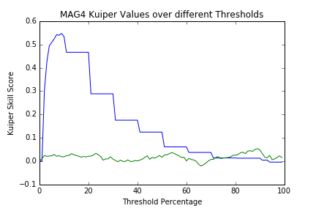
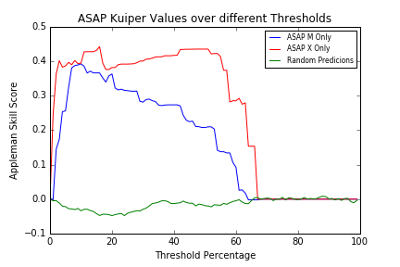
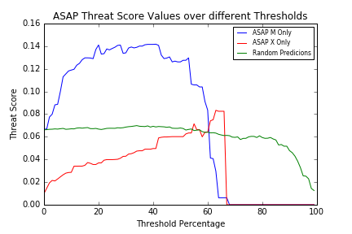
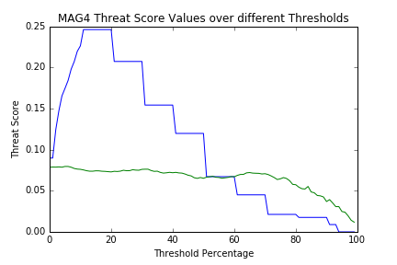
Other Skill Scores
Kuiper measures the relation between

Slide 13
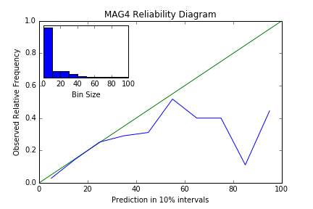
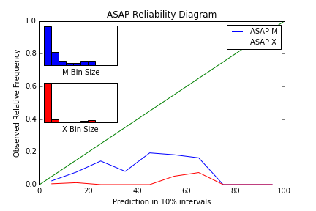
Reliability Diagrams
Reliability diagrams plot prediction values vs. observed relative frequency to measure how accurately a model predicts events
For prediction values of 30%, a perfect forecast would give an observed frequency of .30 because there would be a hit 30% of the time. The closer the observed frequency is to the line y = x, the better the forecast.
These graphs tell us that at low probability bins, the graphs are relatively close to y=x, but they deviate greatly at higher percentages (overpredicting)
Notes:
Reliability diagrams plot prediction values vs. observed relative frequency to measure how accurately a model predicts events^{2,3}. Prediction values are the hourly percentages the model forecasts, and the observed relative frequency is the amount of hits per bin, where a bin is the number of predictions that fall in each 10% probability interval.
For prediction values of 30%, a perfect forecast would give an observed frequency of .30 because there would be a hit 30% of the time. The closer the observed frequency is to the line y = x, the better the forecast. These graphs tell us that at low probability bins, the graphs are relatively close to y=x, but they deviate greatly at higher percentages.
-Reliability diagrams plot prediction values vs. observed relative frequency to measure how accurate the model predicts events. The closer the observed frequency is to the line y = x, the better the forecast.
-For MAG4, the graph shows low prediction percentages fairly close to y = x, but as the values increase, the observed frequency deviates further. For ASAP M the low prediction values are relatively close to y = x, but they begin to get very far away rapidly. ASAP X predictions are never near the line.
-These graphs tell us that the prediction percentages are not useful for predicting flares at an accurate percentage; flares are overpredicted. However, from further analysis we determined that the models are useful for sending an increased flare notification to our end-users when threshold percentages are crossed.

Slide 14
Threshold Determination
Notes:
-For the lower threshold, we tolerated a larger amount of false positives to reach an 85% successful flare prediction rate (true positives). This threshold is designed for an end-user who is at high risk for damage from flare-related events and hopes to get an early warning for as many as possible.
-The higher threshold reduces the number of false positives to a maximum of 10% while still catching at least 60% of flares. Our goal was to give end-users the opportunity to choose if they want to receive less notifications with a higher threshold.

Slide 15
Notification Sample
Flare models _______ have crossed the flare probability threshold of ____. There is a heightened probability for the occurrence of ___ class flares for the next 24 hours. Please note that this is a model-based predictive tool that is still under testing.

Slide 16
Hurdles to Implementation
False positive minimization still results in a large quantity of predictions above threshold
The number of false notifications this would result in is yet to be determined
Lack of analysis for ASSA
Improvement of the models

Slide 17
Conclusion
While the probabilistic results of both models become less reliable (over-forecasting) as the predicted chance of flaring increases, their skill scores indicate that they still have valuable predictive power. Furthermore, our threshold analysis shows that the probabilistic forecasts can be collapsed to a yes/no decision on notifying mission operators of increased flare likelihood– with confidence that 85% of flares will be successfully predicted or confidence that 90% of all other predictions will not be false positives.

Slide 18
Acknowledgments
We would like to thank Yihua Zheng for her mentorship, and Antti Pulkkinen, Leila Mays, and Barbara Thompson for their guidance. We also thank Sandro Taktakishvili, Karin Muglach, Yari Collado, Anna Chulaki and Chigomezyo Ngwira for their instruction. We thank the CCMC, Masha Kusnetsova, SWRC, and the Catholic University of America for supporting our internship. Finally, we thank NASA and the SESI program for providing us with this opportunity.

